Slide 1

QA Book
www.qabook.com

Slide 2
Available versions
Peer to peer solution (Free)
Fully licensed
Build up local repository of requirements and test cases
Export to QABook file types or excel
Upload to a centralized repository
Client Server Solution
Allows simultaneous work for multiple users
Allows user permission settings
30-day free trial

Slide 3
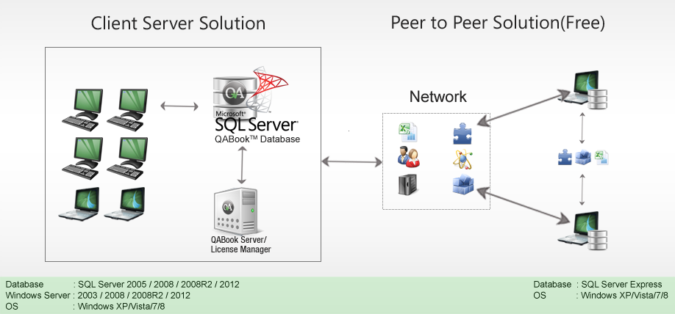
Available versions

Slide 4
What’s good
Complete feature rich test management solution
Features are not limited in the free version only collaboration
UI
Raise defects
Report generation
Import from Excel

Slide 5
What can be better (in the free version)
Complicated team collaboration in the free version
Lack of access restrictions in the free version

Slide 6
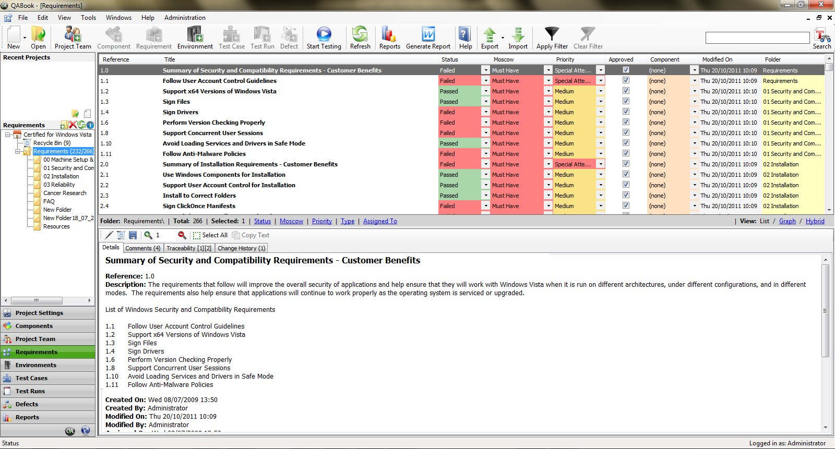
Live Demo

